Slide 1

Machine Learning-Based Smart Irrigation Control Using Weather and Soil Analytics
ITA 0609-Machine Learning
Under the Guidance of :
Dr. Shri Vindhya
Presented By :
S. Venkatesh (192312109)
V.Siddardha(192312075)
Y.S Anil Prasad(19232035)

Slide 2


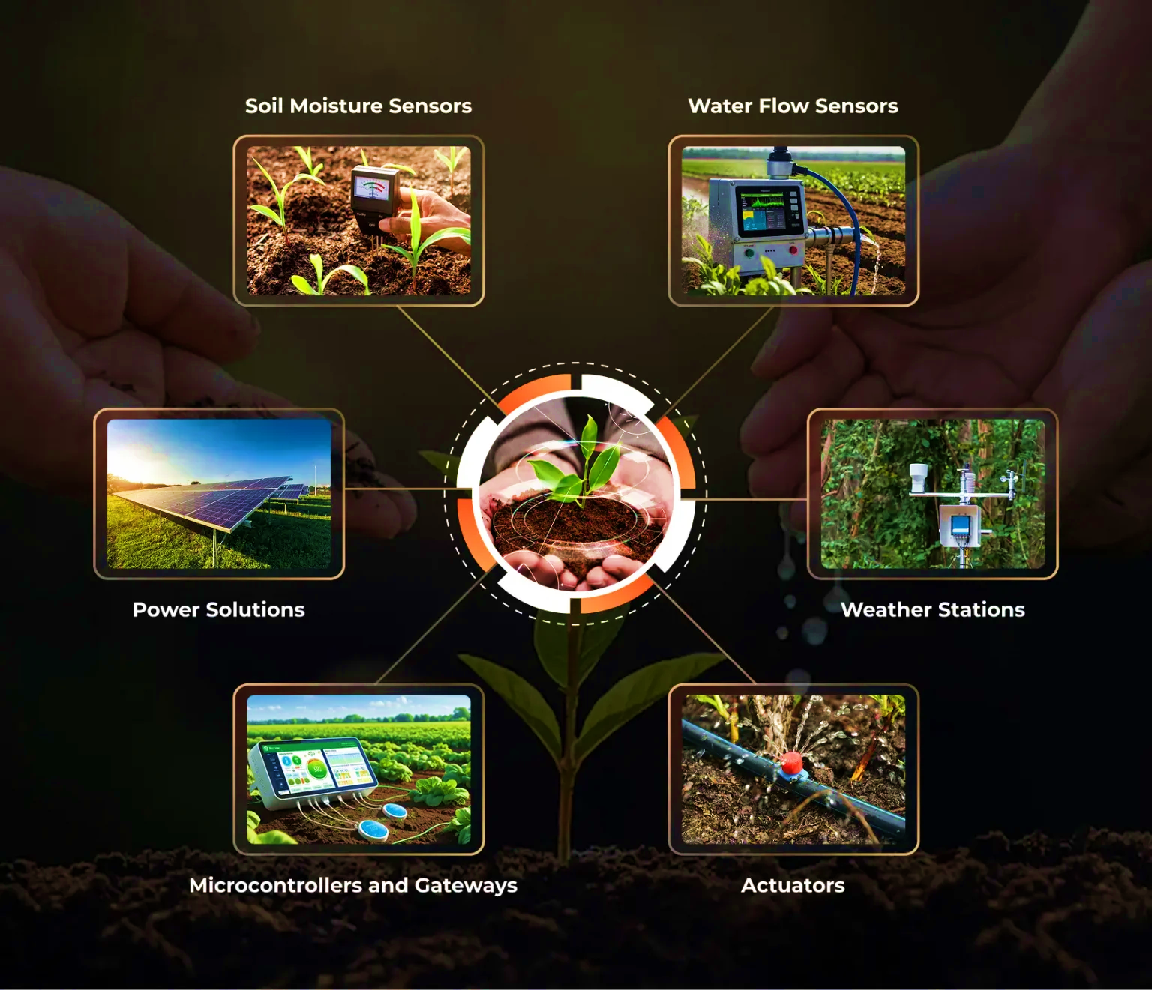
Introduction
Agriculture depends on efficient irrigation for healthy crop growth and better productivity.
Traditional irrigation methods often waste water because they do not consider weather and soil conditions.
Machine Learning enables intelligent irrigation by analyzing weather and soil data to predict water requirements.
The proposed project develops a predictive model that recommends whether irrigation is needed.
This approach helps conserve water, improve irrigation efficiency, and support sustainable farming practices.

Slide 3
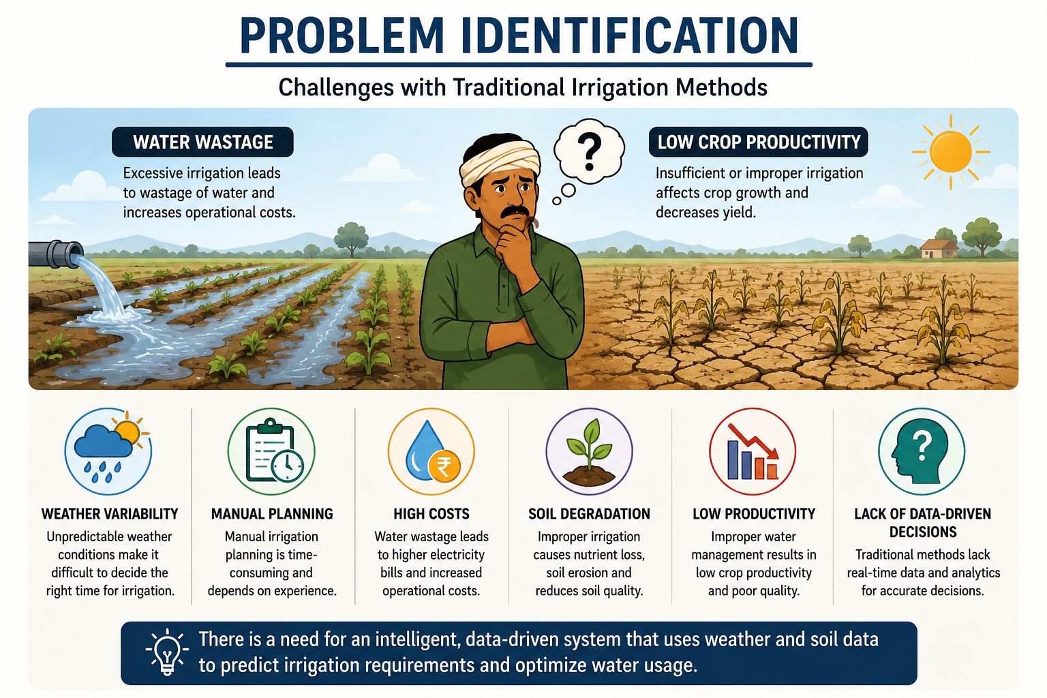
Problem Statement
Traditional irrigation methods do not consider changing weather and soil conditions.
Excessive irrigation leads to water wastage and higher operational costs.
Insufficient irrigation negatively affects crop growth and yield.
Manual irrigation planning is time-consuming and prone to errors.
Unpredictable weather makes irrigation scheduling difficult.
A data-driven system is needed to predict irrigation requirements accurately.

Slide 4

Objectives & Scope
Develop a Machine Learning model to predict irrigation requirements.
Analyze weather and soil parameters affecting irrigation.
Improve irrigation efficiency through accurate predictions.
Reduce unnecessary water consumption.
Support sustainable and precision farming practices.
Scope
Applicable to agricultural fields, gardens, and greenhouses.
Supports irrigation planning using historical and environmental data.
Can be extended with IoT devices and mobile applications.
Suitable for different crop types and farming environments.

Slide 5
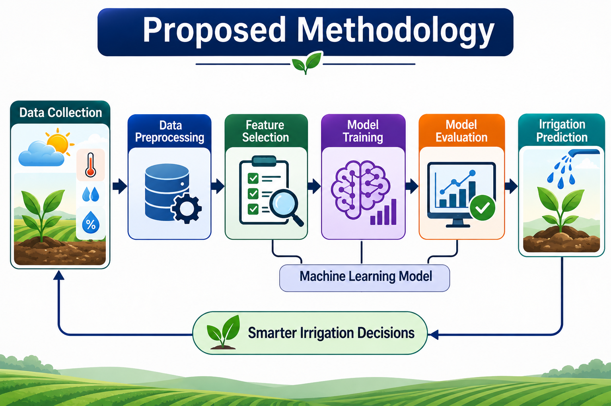
Methodology
Collect agricultural datasets containing soil and weather information.
Preprocess the data by handling missing values and normalizing features.
Select relevant parameters such as soil moisture, temperature, humidity, and rainfall.
Train and test Machine Learning algorithms such as Decision Tree and Random Forest.
Evaluate model performance using accuracy and other classification metrics.
Use the trained model to predict whether irrigation is required based on new input data.

Slide 6
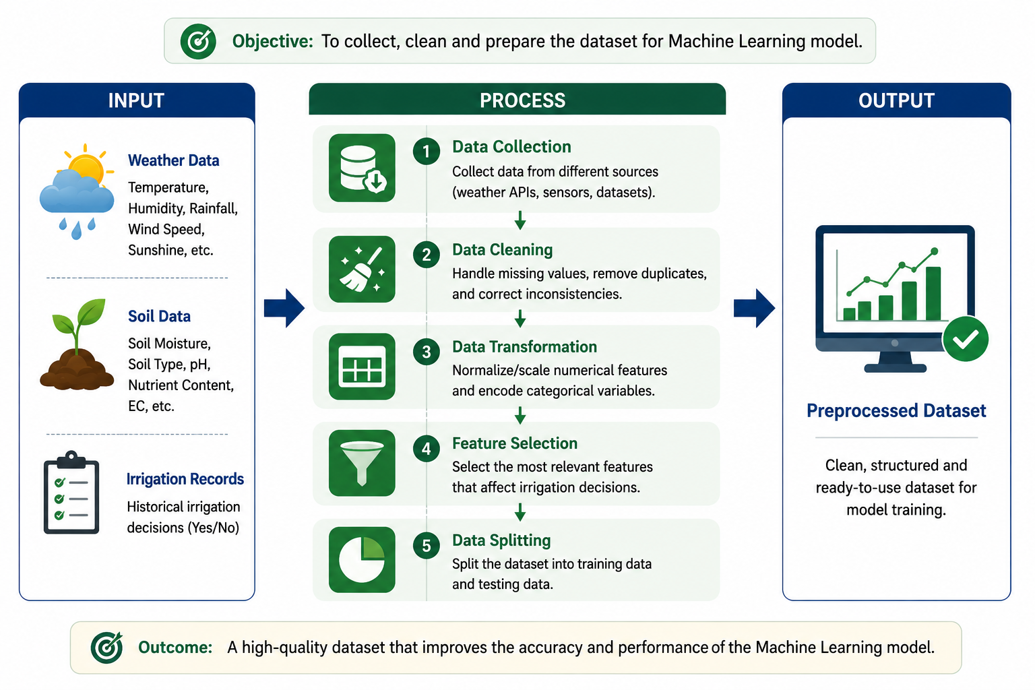
Module 1: Data Collection and Preprocessing
Collect historical weather and soil datasets.
Gather features such as temperature, humidity, rainfall, and soil moisture.
Clean the dataset by removing missing and duplicate values.
Normalize and transform data for better model performance.
Select relevant features affecting irrigation.
Split the dataset into training and testing data.

Slide 7
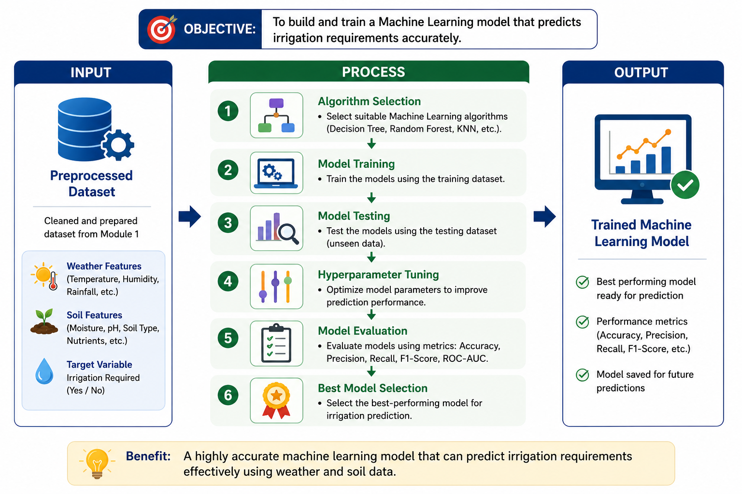
Module 2: Machine Learning Model Development
Select suitable Machine Learning algorithms.
Train the model using the prepared dataset.
Compare algorithms based on prediction performance.
Optimize model parameters for better accuracy.
Evaluate the model using Accuracy, Precision, Recall, and F1-Score.
Select the best-performing model for irrigation prediction.

Slide 8
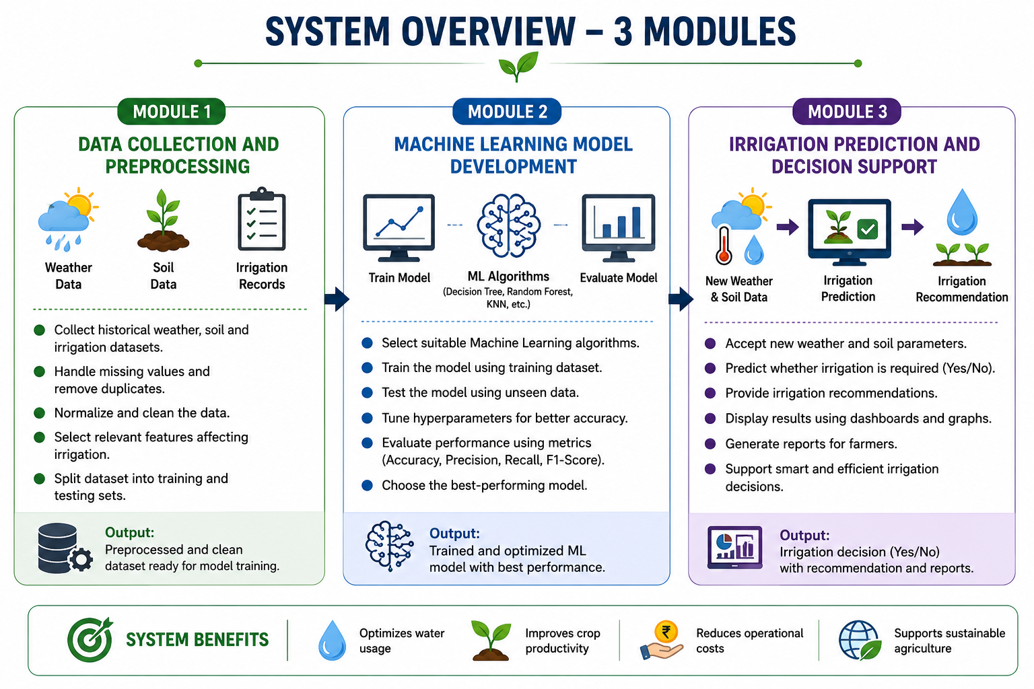
Module 3: Irrigation Prediction and Decision Support
Accept new weather and soil parameters as input.
Predict whether irrigation is required.
Generate irrigation recommendations based on predictions.
Display prediction results through charts or dashboards.
Assist farmers in making informed irrigation decisions.
Improve water efficiency and support sustainable agriculture.

Slide 9
Dataset & Output
Soil Moisture (%) | Temperature (°C) | Humidity (%) | Rainfall (mm) | Soil Type | Crop | Irrigation Required
22 | 35 | 48 | 0 | Loamy | Rice | Yes
65 | 28 | 70 | 12 | Clay | Wheat | No
30 | 33 | 55 | 2 | Sandy | Maize | Yes
80 | 26 | 82 | 18 | Clay | Rice | No
25 | 36 | 44 | 0 | Sandy | Cotton | Yes
72 | 29 | 65 | 10 | Loamy | Wheat | No
40 | 31 | 58 | 3 | Loamy | Maize | Yes
90 | 24 | 88 | 25 | Clay | Rice | No
18 | 38 | 42 | 0 | Sandy | Sugarcane | Yes
68 | 27 | 72 | 15 | Loamy | Cotton | No

Slide 10
Conclusion
The proposed Machine Learning-based Smart Irrigation System provides an intelligent approach to irrigation planning by analyzing weather and soil data.
The developed predictive model helps determine whether irrigation is required, improving the accuracy of irrigation decisions.
The system aims to reduce unnecessary water consumption, improve crop productivity, and support efficient resource management.
By using data-driven analysis, the project promotes sustainable and precision agriculture practices.
This solution can be further enhanced with IoT devices, real-time weather data, and mobile applications for practical field deployment.

Slide 11


